Slide 1
W09D1
Time Series I
Instructor: Eric Elmoznino
Notes:
Time series refer to data that is sequential in nature. For instance, data of a stock price over time.
Lecture will be a condensed version of exercise topics.
Fun first half of lecture. Lots of intuitive and visual concepts.
Difficult second half. Many new concepts going into a complicated model for time series forecasting. We’re not going to go into full details for it, so it will inevitably seem like a bit of a grey box.

Slide 2
Outline for today (part 1)
Overview
Examples
Ordered data points
Independent variable is the dependent variable
Automatic ground-truth
Analysis and forecasting
Simple technique: moving average
Data preprocessing
Feature engineering
Prediction

Slide 3
Outline for today (part 2)
Time series components
Level, trend, seasonality, and residual
Time series decomposition
Stationarity
Meaning and importance
Augmented Dickey-Fuller test
ARIMA and Box-Jenkins methodology
AR (autoregression)
MA (moving average)
ARIMA (autoregressive integrated moving average)
Box-Jenkins methodology

Slide 4
Overview

Slide 5
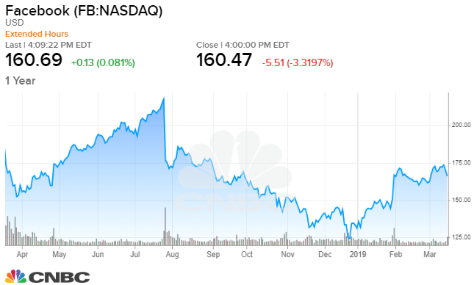
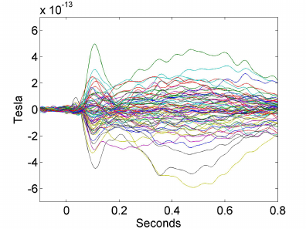
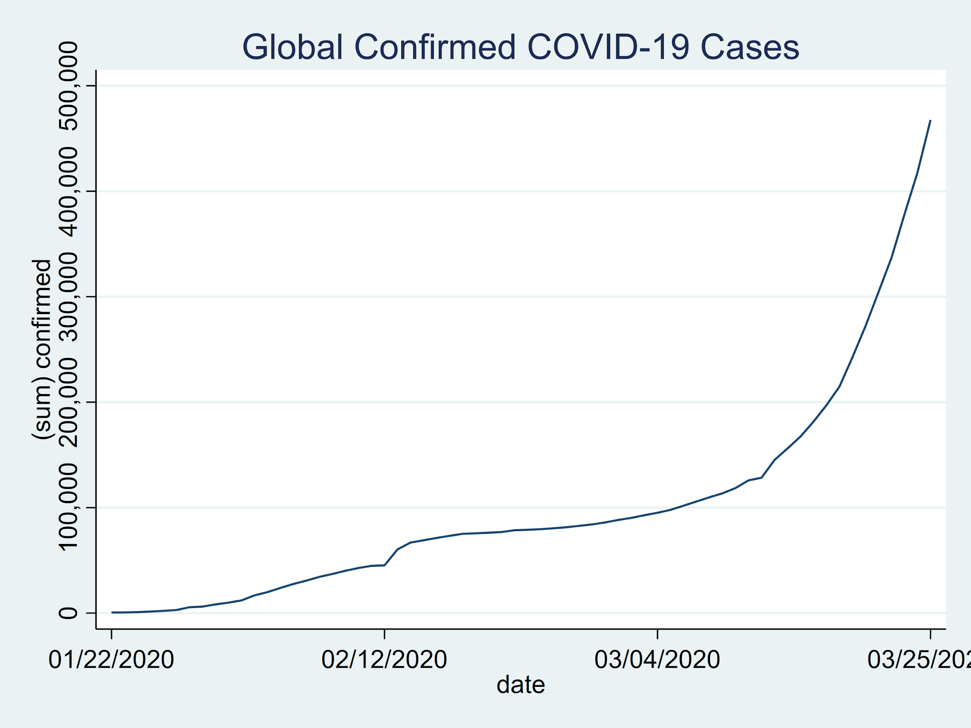
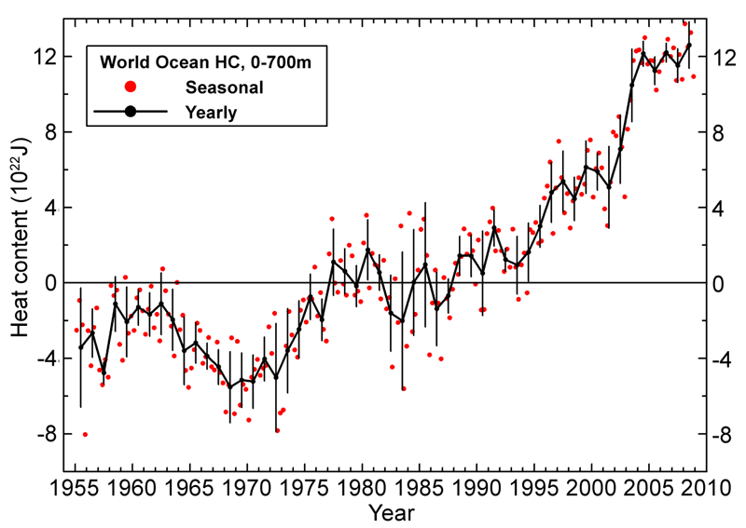

Examples
Stock price
MEG (multidimensional)
Infection rates
Weather/temperature
Video (multidimensional)
Notes:
Can someone tell me an example of another kind of time series we’ve worked with so far? Last week maybe.
Language is a multidimensional time series. Every word is a vector, and we’re trying to extract information from a sequence of vectors.
Did we treat it as a time series? Did we preserve the ordering of the words in how we represented language?

Slide 6
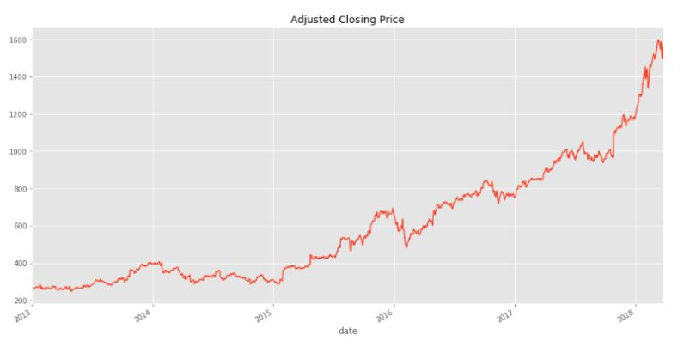
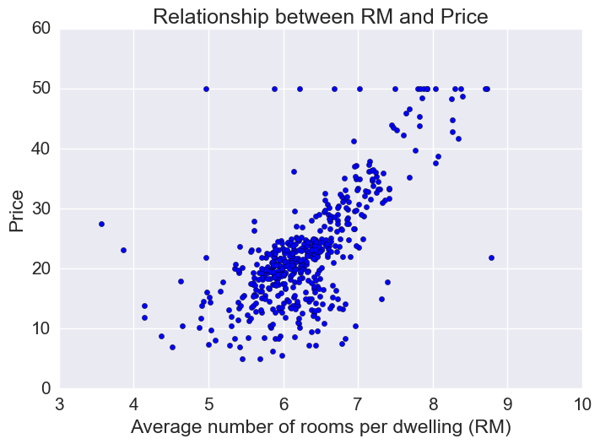
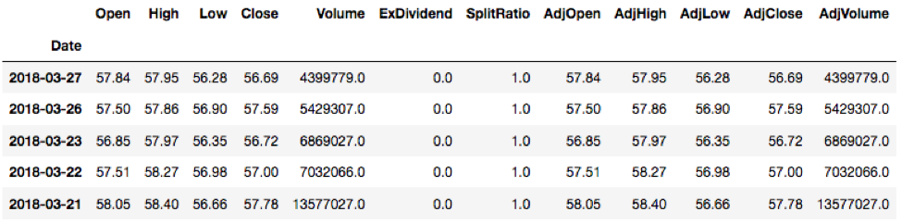
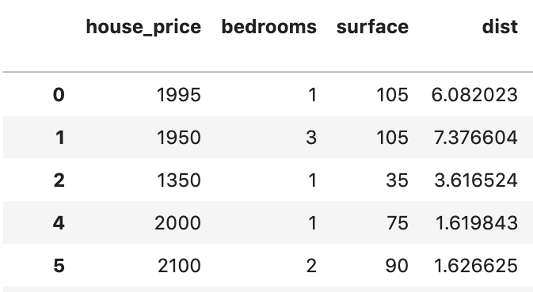
Ordered data points
Time series
Other data
Notes:
1) Data points (rows) are no longer independent samples! They will be correlated. In the past, we could reshuffle our datapoints and it would have made no difference; the order was arbitrary. Not with time series data.
2) Breaks assumption behind many models (e.g. linear regression), which assume that your data nicely ranged over the entire space of possible inputs, no sampling bias. Here, we only have inputs over a specific range. Imagine training a linear regression model over 2013-2018 and then testing it on 2020, it would fail completely.
Luckily, also a blessing, for reasons that we’re about to see.

Slide 7
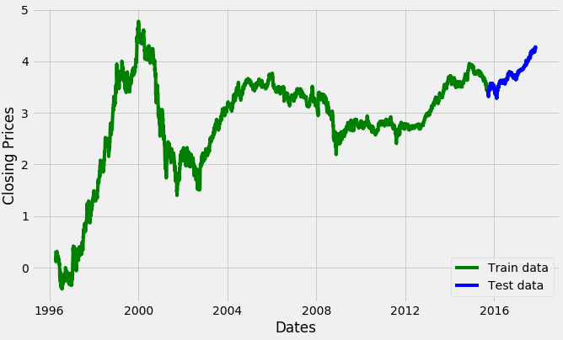
What features could you use?
Notes:
Imagine you’re an investor who wants to predict what Uber’s stock price will be on a particular day. What features would you use?
News articles?
Rumours?
Revenue reports?
The past stock price. Patterns in the stock price itself!
Because data points are correlated in time, can use dependent variable to predict itself at a later time. Use the past to predict the future.
Notice doesn’t make sense for other datasets we’ve been using. Can’t use one house’s sale price as a feature to predict some other house’s sale price.

Slide 8
Independent variable is a dependent variable
Notes:
Imagine you’re an investor who wants to predict what Uber’s stock price will be on a particular day. What features would you use?
News articles?
Rumours?
Revenue reports?
The past stock price. Patterns in the stock price itself!
Because data points are correlated in time, can use dependent variable to predict itself at a later time. Use the past to predict the future.
Notice doesn’t make sense for other datasets we’ve been using. Can’t use one house’s sale price as a feature to predict some other house’s sale price.

Slide 9
Generating a supervised learning dataset
x_{t-2} | x_{t-1} | y_{t}
- | - | obs1
- | obs1 | obs2
obs1 | obs2 | obs3
obs2 | obs3 | obs4
... | ... | ...
Notes:
Since we are predicting the future from the past, we can massage our data into a form where we’ll be able to apply all the supervised learning techniques we’ve learned so far.
Use a long historic period. Output variable will be the original time series, input variables will be time lagged copies of it.
Can also do online training and improve model in production as new data comes in. Can make model robust to changing trends after deployment.

Slide 10
Generating a supervised learning dataset
x_{t-2} | x_{t-1} | y_{t}
- | - | obs1
- | obs1 | obs2
obs1 | obs2 | obs3
obs2 | obs3 | obs4
... | ... | ...
Notes:
Since we are predicting the future from the past, we can massage our data into a form where we’ll be able to apply all the supervised learning techniques we’ve learned so far.
Use a long historic period. Output variable will be the original time series, input variables will be time lagged copies of it.
Can also do online training and improve model in production as new data comes in. Can make model robust to changing trends after deployment.

Slide 11
Generating a supervised learning dataset
x_{t-2} | x_{t-1} | y_{t}
- | - | obs1
- | obs1 | obs2
obs1 | obs2 | obs3
obs2 | obs3 | obs4
... | ... | ...
Notes:
Since we are predicting the future from the past, we can massage our data into a form where we’ll be able to apply all the supervised learning techniques we’ve learned so far.
Use a long historic period. Output variable will be the original time series, input variables will be time lagged copies of it.
Can also do online training and improve model in production as new data comes in. Can make model robust to changing trends after deployment.

Slide 12
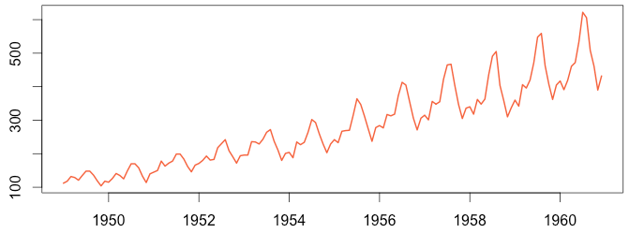
Analysis and forecasting
Analysis
Prediction
Extract meaningful statistics/characteristics
Autocorrelation: over how long does it correlate with itself?
Trend: how is it changing over the long-term?
Seasonality: what are the timescales of repeating patterns?
White noise: is it just random over time?
Forecasting: predict the future from the past
Anything else you have labels for!
Notes:
E.g. other prediction task: Based on the time series of weather, how many accidents were there that year?

Slide 13
Simple technique: moving average
Notes:
To get you used to things we can do with time series, we’ll look at a simple concept, the moving average, and see how it can be used in both time series analysis and forecasting.

Slide 14
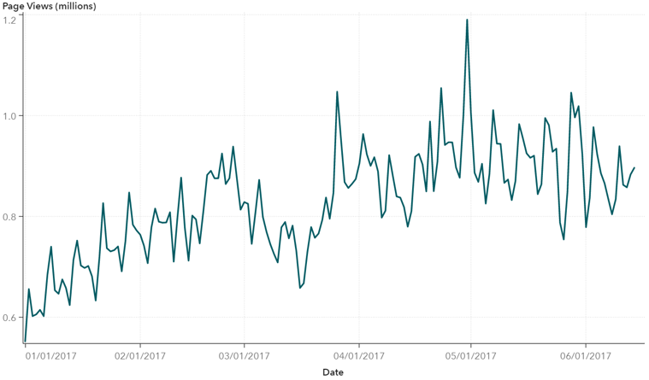
The moving average
Window size
Mean in window

Slide 15
The moving average

Slide 16
The moving average

Slide 17
The moving average

Slide 18
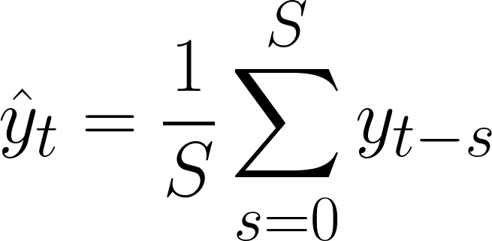
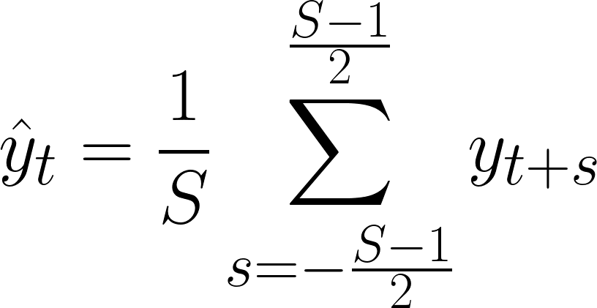
The moving average
Trailing moving average
Trailing
Centre moving average
Centre

Slide 19
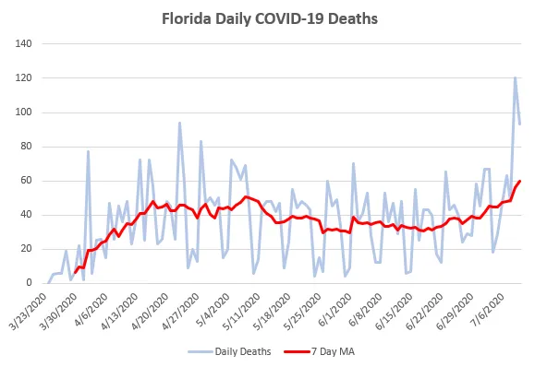
Moving average for data preprocessing
Smoothing/Denoising
Can better see the trends by averaging out the noise

Slide 20
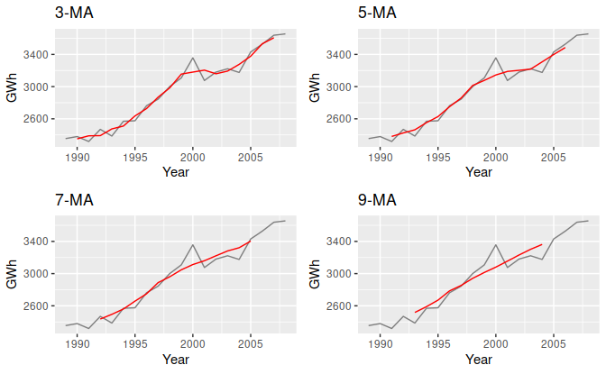
Moving average for data preprocessing
Notes:
Too much smoothing might be bad. You can smooth out not only random noise, but also important signal (imagine you smoothed out for the entire data period).
Amount of smoothing that is appropriate will depend on your data. For 1-dimensional data, easiest to judge by plotting.

Slide 21
Moving average for feature engineering
X
Y_{t-1} | Moving Average (past 3 days) | Y_{t-1} / Y_{t-10}
... | ... | ...
y
Y_{t}
...
Notes:
Certainly not limited to just moving averages. You can apply any function you want to the past and use it as a feature for a model that predicts the future.
For instance, over here I also have the ratio of increase in the past 10 days as a feature.
Can get more creative than that. For the engineers in the audience, a very useful feature to add is often the frequency spectrum over some interval in the past.
Your feature engineering is no longer restricted to just the columns of the data. You can apply feature engineering functions across rows, across time points.

Slide 22
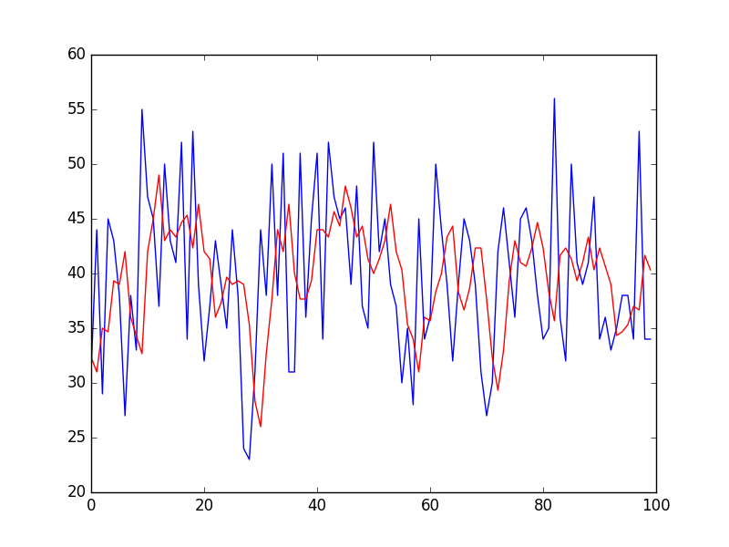
Moving average for prediction
MA prediction
Data
y(t) = TrailingMA(t-S, t-1)
Assumption:
The future will look like the past (but less noisy).
Notes:
Not a perfect prediction model. Saying that the future will be just like the past. Will therefore lag behind the true values, since they only get incorporated into the mean after the prediction.
Because a mean is being taken over the past, individual time points can get averaged out and affect the predictions less. The mean will be somewhat robust to noise. Just like when smoothing, bigger windows of the mean will ignore more and more noise. However, they might also remove more signal, and will cause a bigger lag (since the past has more and more influence on the mean).

Slide 23
Time series components
Notes:
A time series has several components that individually contribute to its value at any given time.
It can be very important to model or decompose the time series into these components, either to know more about the series through analysis or to make accurate predictions.

Slide 24
Time series components
What individual components make up this time series?

Slide 25
Level
The baseline value of a time series
Notes:
Usually not that important in modeling because we can always zero-mean the data.

Slide 26
Trend
The long-term change in a time series
Notes:
Long-term variations in the average value of the series.
Need not be linear.

Slide 27
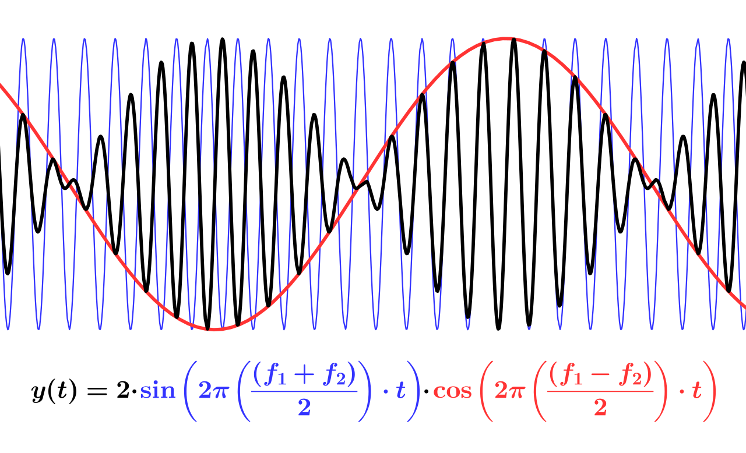
Seasonality
The repeating patterns of a time series
Notes:
Repeating pattern in the time series.
Can happen at any timescale.
The weather obviously has a seasonal affect at the timescale of a year, going between summer and winter. The actual seasons.
Stock prices have seasonal factors going on at the scale of days. There is a rough pattern from open to close of how the price changes, although it is a relatively weak effect.
A time series can have different seasonal effects at multiple timescales.
The weather also fluctuates over a much larger period, which is what causes ice ages and warmer periods.
Multiple trends at several timescales can make seasonality very difficult to model, especially when the seasonal effects are independent and not in phase of one another, because they all get mixed up.

Slide 28
Residual
The remaining variation not captured by the other components
Notes:
Everything that’s left. Short-term effects, noise in the data that you can’t model, contributions from factors outside of the time series itself, or short-term correlations in the data.
For instance, if you were modeling the stock market, day-to-day rumours and emotions causing price fluctuations would not play a part in the long-term trend and wouldn’t have any seasonal pattern.

Slide 29
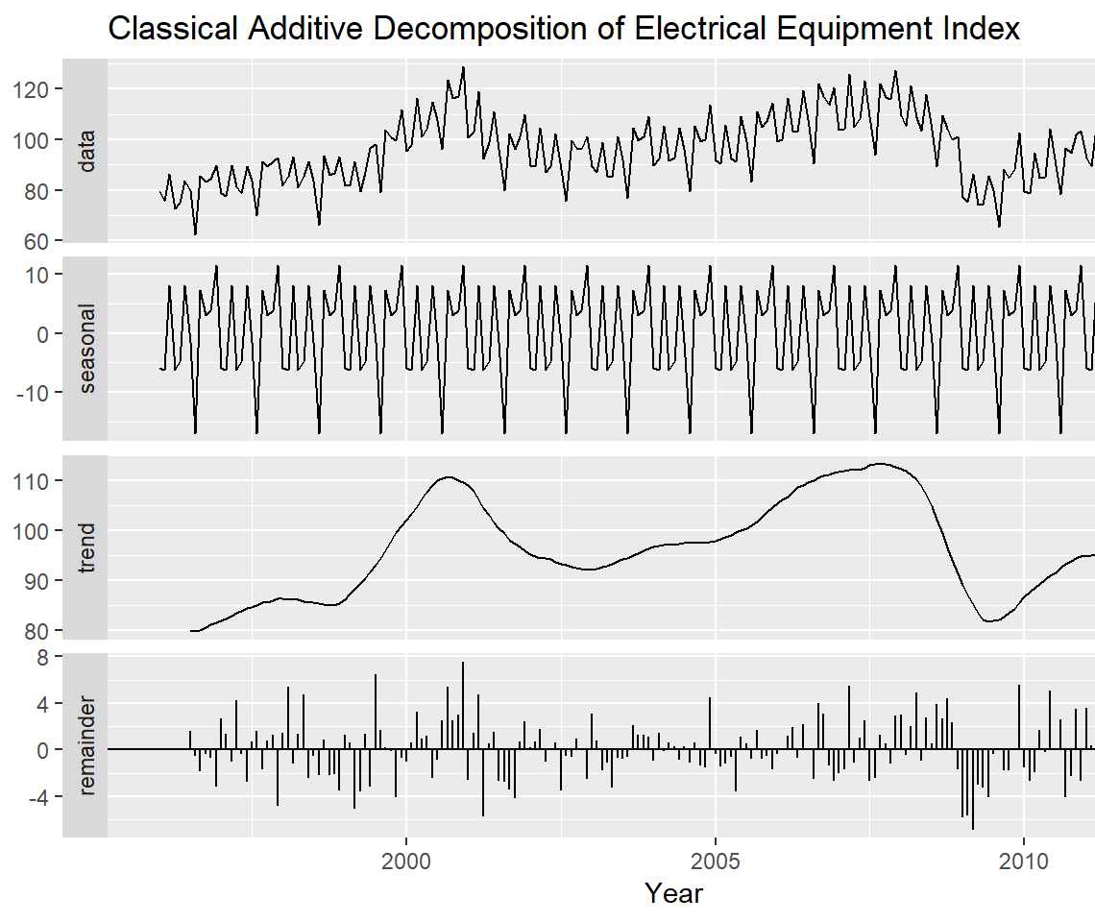
Time series decomposition
Additive model
Notes:
Easy to see how these methods work in principle.
Ignore the level component and just subsume it in the trend component. Trend won’t be zero-mean. So what, big deal.
First, find the trend, which is something like a moving average at a longer timescale than the seasonal component. Subtract the trend from the series.
Like looking at the average temperature each year over multiple decades.
Second, if you know the period of seasonality (its duration), then divide the series into chunks of that size and average each of them. Repeat that seasonal component across the whole time series and subtract it from the rest.
After you’ve subtracted the global temperature trends across years, average the remainder across years. You’ll get the average seasonal trend of how temperature varies in a year.
Finally, what’s left after subtracting the trend and seasonality components is just the residual component.
In practice, easier said than done. Automatic methods that apply algorithms like this one do well on some time series, but not well on others. Difficult to know how big a Moving Average window to use for recovering the trend, and difficult to automatically determine what the period of seasonality is.

Slide 30
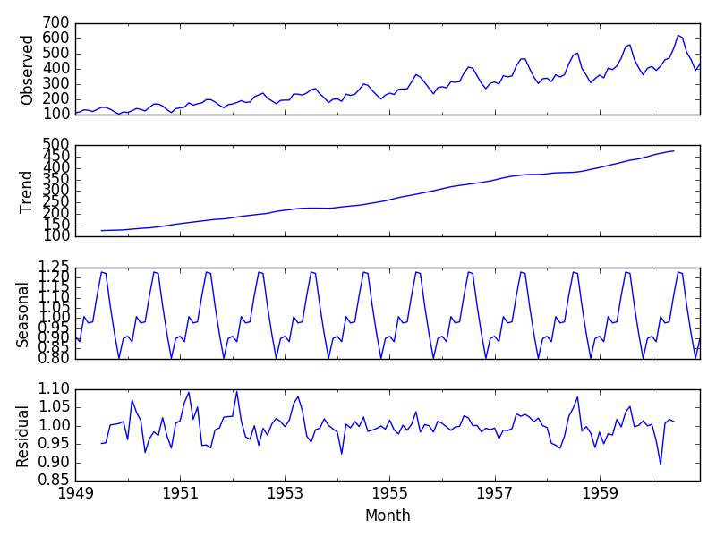
Time series decomposition
Multiplicative model
Notes:
When multiplicative, will see the seasonality component and the residuals growing or shrinking over time as the trend does. The trend is scaling the contributions of those other components.
Additive and multiplicative models are not always the true way that these different components interact. They are models that often yield good approximations.

Slide 31
Stationarity

Slide 32
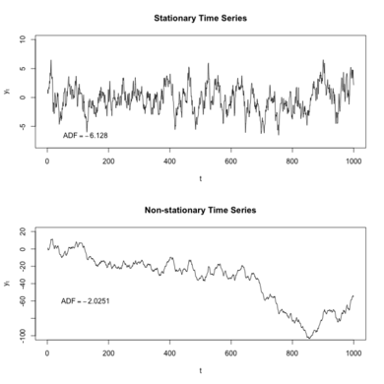
Meaning and importance
A time series is stationary if its statistical properties (e.g. mean, variance) are constant over time
Requires that there is no trend and/or seasonal component
Problem: most classical time series models assume stationarity
Strategies:
Check if data is stationary
If it isn’t, try to remove trend and seasonal components
Notes:
Doesn’t necessarily mean that each time point is completely independent of the others. If it did, then forecasting on a stationary time series would be impossible.
Nearby time points can be correlated, as long as there is no long-term trend or repeating pattern. Essentially, anywhere you look at the time series, it has to kind of look the same.
Intuition: if something has constant behaviour over time, then it is easy to predict what it will do in the future. A lot of models try to learn the temporal statistics across the dataset by assuming stationarity.

Slide 33
Checking for stationarity
Looking at the plot for trend/seasonality
Constant statistics (e.g. histogram, mean, variance of different segments)
Hypothesis testing

Slide 34
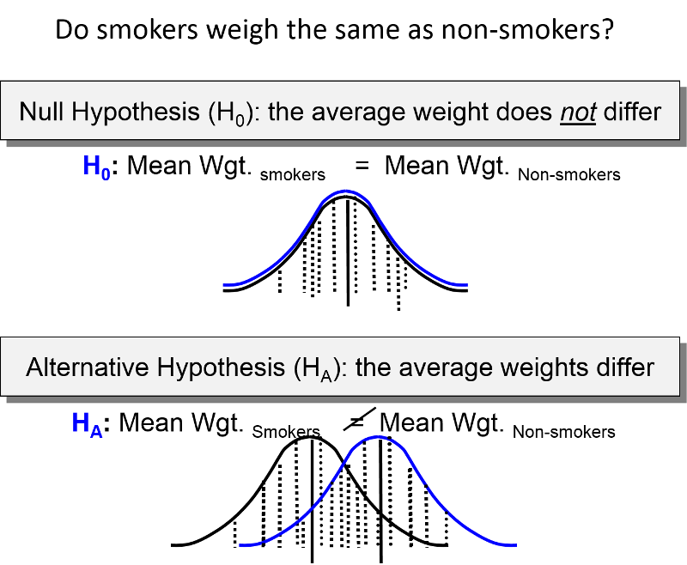
Review: hypothesis testing
Null hypothesis: the default belief
P-value: the probability of observing the data you did if the null hypothesis were true
The lower the p-value, the more evidence you have to reject the null hypothesis
By convention, people reject the null hypothesis when p < 0.05

Slide 35
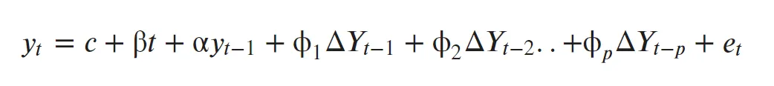
Augmented Dickey-Fuller test
Test for stationarity
Input: a time series
Null hypothesis: the data is non-stationary
Output: probability that the data is non-stationary
P < 0.05: strong evidence that the data is stationary
P >= 0.05: insufficient evidence that the data is stationary
Fits this regression model, and null hypothesis assumes alpha=1 Explanation
Notes:
Important: If your p-value is above 0.05, doesn’t necessarily mean that your data is non-stationary. Just means you don’t have enough evidence to prove otherwise. Maybe you don’t have enough data to be confident that the data is stationary. An important distinction to make for hypothesis tests in general. The p-value being greater than 0.05 never means that the null hypothesis is true, if just means that you haven’t proved it’s false.
Details of the test are complicated and I don’t think there’s much value in going into them today.

Slide 36
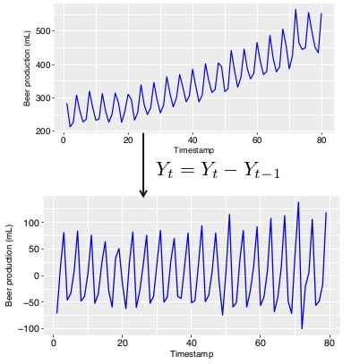
What to do if data is non-stationary?
Decomposition: techniques to model then remove seasonality/trend
Differencing: subtracting lagged versions of the series to remove trend
Can do this multiple times (differencing order)
Warning: too many times can introduce artifacts
Use a model that can handle non-stationary data
e.g. recurrent neural network
Differencing
Notes:
Example: imagine what differencing would do to a sloped line. It would turn it into a constant line.

Slide 37
ARIMA and Box-Jenkins methodology
Notes:
ARIMA model composed of 3 components:
AR stands for autoregressive model.
I stands for integrate.
MA stands for moving average model.
Box-Jenkins is just a workflow for training ARIMA models.

Slide 38
Correlation with lag
Correlation > 0
Lag = 2 years
Notes:
We need two background statistical concepts before talking about how to use ARIMA.

Slide 39
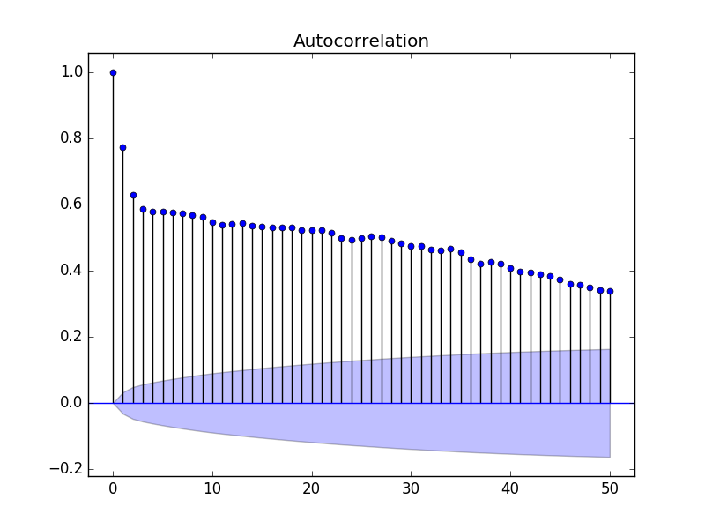
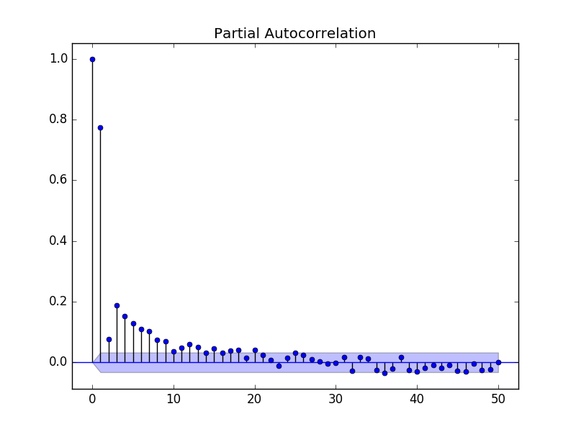
Autocorrelation and partial autocorrelation
y_{t-2}
y_{t-1}
y_{t}
Correlation of a time series with lagged versions of itself (x-axis shows the lag interval)
Correlation of a time series with lagged versions of itself unaccounted for by subsequent observations
Notes:
Clouds at the bottom show 95% confidence intervals. If a correlation is greater than those, then we can say we are confident that correlation is real and not a fluke in the data.
Can think of autocorrelation as “which past time points are correlated with the present”.
Can think of partial autocorrelation as “which past time points have a direct causal effect on the present”.
PACF direct effect example: In music, the chord progressions have predictable structure with long-range dependencies. Knowing what chord was played two measures ago will have an effect on what chord will be played next, and part of that effect is independent of what chord was played last measure. There’s some indirect effect, but also some direct effect.

Slide 40
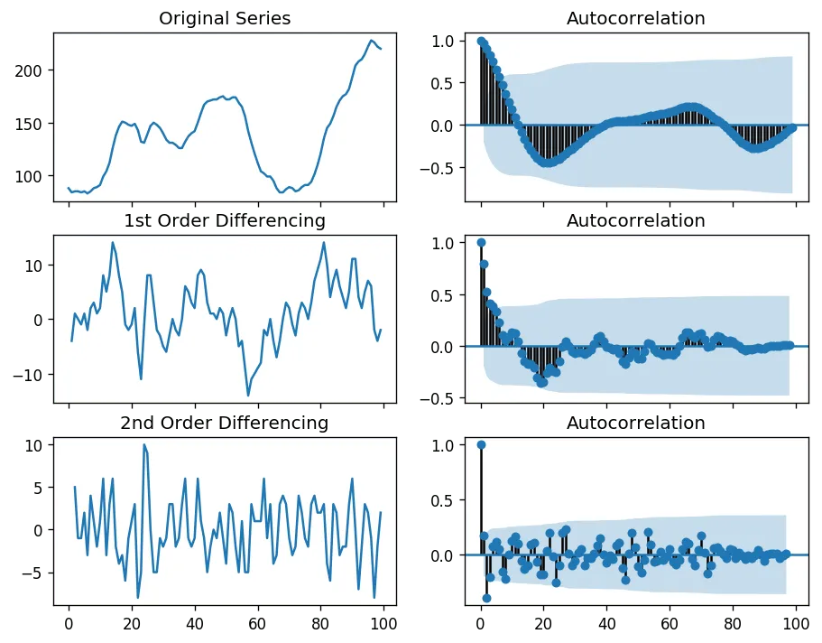
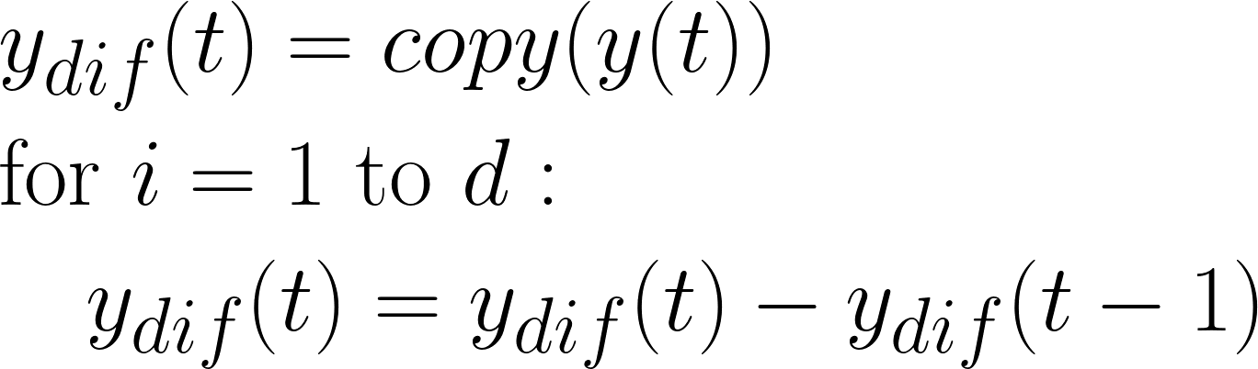
Integrate (I)
Pick d to reduce autocorrelation without introducing artificial correlations (d=1 here). Making the time series stationary
Notes:
In ARIMA, first step is Integrate (the “I” part).
Misnomer, really just means apply differencing until the data is stationary without introducing new serial (i.e. temporal) correlations.

Slide 41
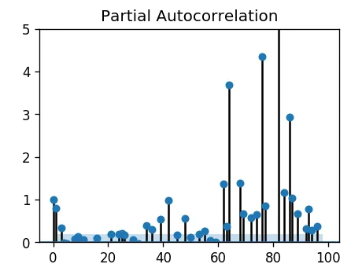
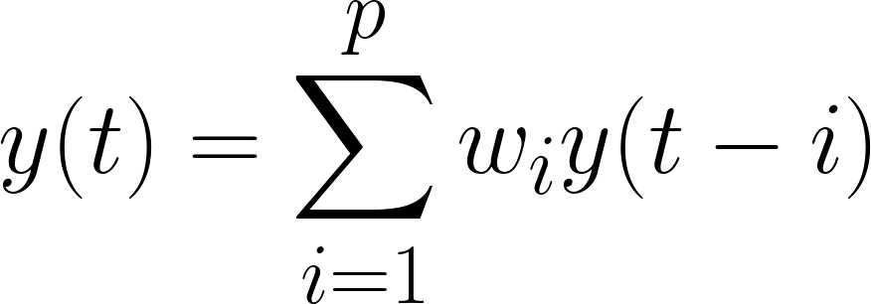
Autoregression (AR)
Pick p after which the partial autocorrelation is no longer significant (p=1). Maximum past time on which y(t) depends
Notes:
Similarly to how autocorrelation was correlating a variable with lagged versions of itself, autoregression is fitting a regression model to a variable using lagged versions of that variable

Slide 42

Moving Average (MA): Intuition
Use past prediction errors to compute future values
Last month (t-1)
This month (t)
Orders (y_{t-1}): 11,500
Available (ŷ_{t-1}): 10,000 Error (Ɛ_{t-1} = y_{t-1} - ŷ_{t-1}): 1,500
% staying (ϕ): 0.5
Prediction (ŷ_{t} = ϕ * Ɛ_{t-1}): 750
Notes:
Important: not the same as the moving average methods we saw before. This is a moving average model and you won’t see any averages in the equations.
Analogy to understand why past error can have an effect on future data:
Consider a car manufacturer who manufactured 10000 special edition cars.
This edition was a success and they managed to sell all of them.
But there were some 1500 customers who could not purchase this car as it went out of stock (call this et-1, where e is the error).
Some of these 1500 customers settled buying some other car, but say that half will return the next month when this special edition car is back in stock. Call this proportion of customers phi.
Next month, some of our sales will come from this error term, these customers that didn’t get to buy the car last term. Phi1 * et-1 = 0.5 * 1500.

Slide 43
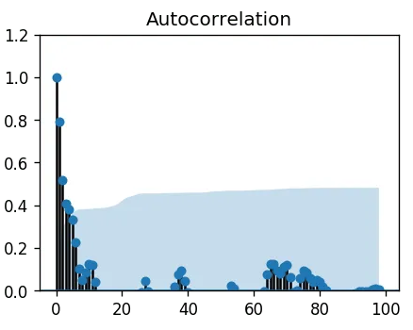
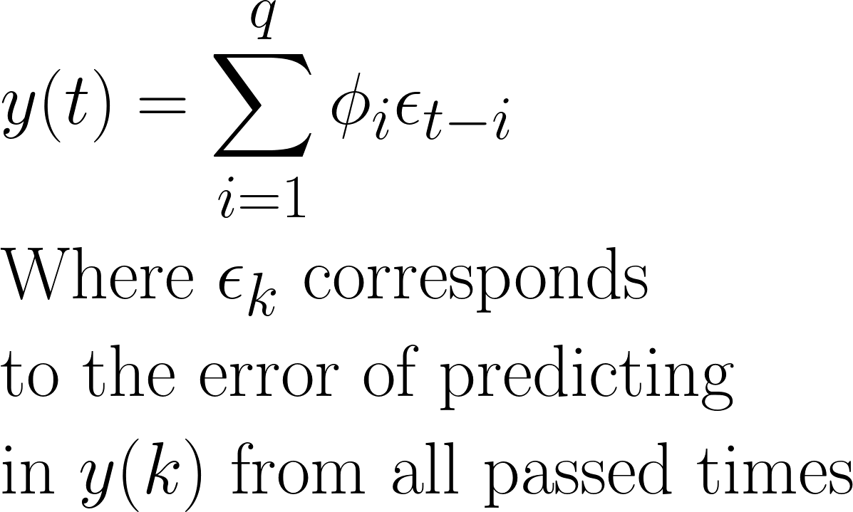
Moving Average (MA)
The exact way this works is pretty complicated. The epsilons and coefficients are computed recursively. See here for more explanations
Pick q after which the autocorrelation is no longer significant (q=2 here). Number of lags required in forecasting to remove all autocorrelation

Slide 44
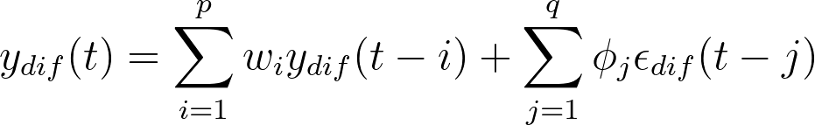
Autoregressive Integrated Moving Average (ARIMA)
Pick hyperparameters d, p, and q

Slide 45
Picking ARIMA parameters
Keep differencing until stationary test passes to pick d
Look for no-significance cutoff in partial autocorrelation to pick p
Look for no-significance cutoff in autocorrelation to pick q
If above not giving clear answers, perform grid search with cross-validation
d
p
q

Slide 46
Box-Jenkins methodology
Iterative 3-step approach to modeling time series
Assumption: time series can be modeled using an ARIMA model
Identification: use data and its statistics to select model hyperparameters
Pick ARIMA p, d, q
Estimation: use data to train the parameters (i.e. weights) of the model
Fit ARIMA on training data
Diagnostic checking: evaluate model for overfitting
Train on older data, evaluate on newer data

Slide 47
Diagnostic checking
Model should not be overfitting
Check performance on an unseen test set (e.g. held out future data)
If overfitting, fit will be excellent on training data but terrible for test data
Residuals (errors) should have no more temporal structure after modeling
Reason: Our goal is for ARIMA to use all the temporal structure to make its predictions. If there is any left after modeling, we haven’t met that goal
Histogram of residuals should resemble zero-centred gaussian white noise
Autocorrelation and partial autocorrelation should be 0 for all lags (no temporal correlations)

Slide 48
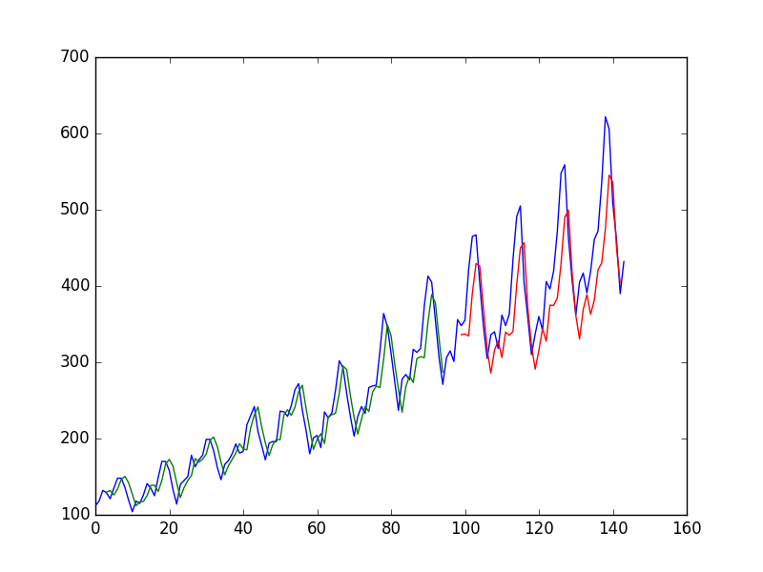
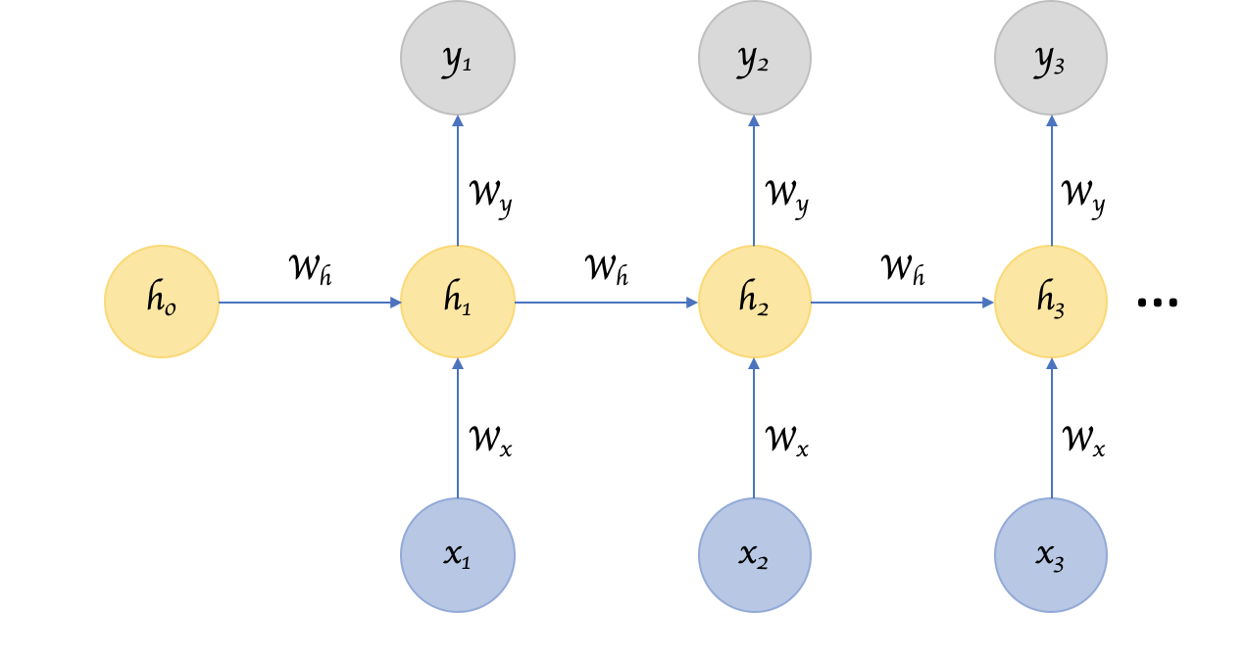
ARIMA sound too complicated?
Use a neural network!
Internal state models trend+seasonality
Recurrent neural network
Notes:
Recurrent neural networks have an internal memory state and every time step they update that state based on the current input. That state is then used to make predictions.
The state can learn to represent things like the trend, or the current position in a seasonal cycle, so you don’t have to worry about your data being nonstationary. It can learn it.
These neural networks are now the state-of-the-art in time series forecasting. Anurag has said that the best models were able to predict the stock market up to 40% accuracy, deep recurrent neural networks have been able to get 94%.

